Slide 1
Shannon Weaver Model
The model is based on the functioning of the radio and telephone
The 3 primary parts of the model
Sender (telephonic speaker) →Telephone (channel/medium)→ Receiver (telephonic message receiver)

Slide 2
Shannon Weaver Model
Their transmission model can be elaborated:
Emissor/Sender/Encoder→ Message/Info.→ Lang.(spoken/written)→ Destination/Receiver
Different steps of the Shannon Weaver Model:
An information source, which produces a message
A transmitter, which encodes the message into signals
A channel, to which signals are adapted for transmission
A receiver, which decodes (reconstructs) the message from the signal
A destination where the message arrives

Slide 3
Shannon Weaver Model
3 problems of this model:
Technical: Problem of accurate transmission/ Disturbance/ lack of signal/ noise
Semantic: Problem of precise meaning/ Misreading of signals and symbols
Effectiveness: Problem of impact on behavior, Feedback related problems, no control over feedback

Slide 4
Linear Model (Laswell, 1948)
Sender→ encodes message→ Receiver decodes message
Communication moves in one direction
No feedback
No effective participation

Slide 5
Interactive/ Convergence Model (Schramm-Wood)
Communication as a two way process
Communication has several reference points: culture, geography, personal experience etc.
Feedback- Verbal, non verbal
Advantage-Close to real life situation
Disadvantage- Feedback may be delayed

Slide 6
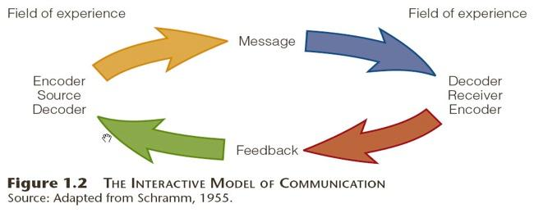
Interactive/ Convergence Model

Slide 7
Interactive/Convergence Model
Also called Convergence Model: Communication converges on the point of feedback
Point of Feedback: Point where messages are understood and replied to
Convergence point: Ensures cyclical nature of communication

Slide 8
Transactional Model
Communication as a dynamic process
All elements in communication cycle interdependent
Roles of speaker and listener interchangeable
Communication is contextual

